Slide 1
Relational Graph Convolutional Networks for Social Network Analysis
Mert Bayraktar
202151075008

Slide 2
Introduction
Social networks are not immune to the presence of malicious bots that engage in automated activities, disseminate misinformation, and engage in spamming or phishing attacks.
Detecting and mitigating these bots is crucial to maintaining a safe and trustworthy online environment for users.
Traditional rule-based heuristics and machine-learning approaches suffer from limitations in capturing the complex and dynamic nature of bot strategies.

Slide 3
Introduction
Graph-based learning provides a versatile framework for handling structured data, where entities are represented as nodes and their relationships as edges in a graph.
GCNs have shown success in capturing local and global structural information from graphs.
However, they often fail to effectively model complex relationships and heterogeneity present in real-world datasets.

Slide 4
RGCN
RGCNs overcome these limitations by explicitly incorporating relational information into the learning process.
RGCNs extend the GCN model by introducing relation-specific parameters and operations. RGCNs enable the learning of relation-specific filters that capture different types of relationships between nodes.

Slide 5
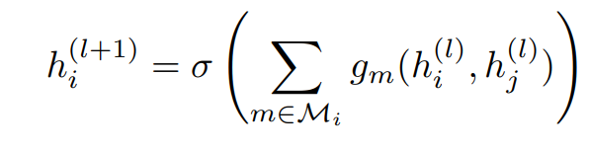
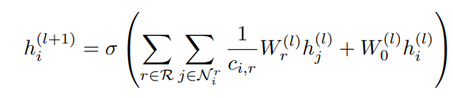
RGCN

Slide 6
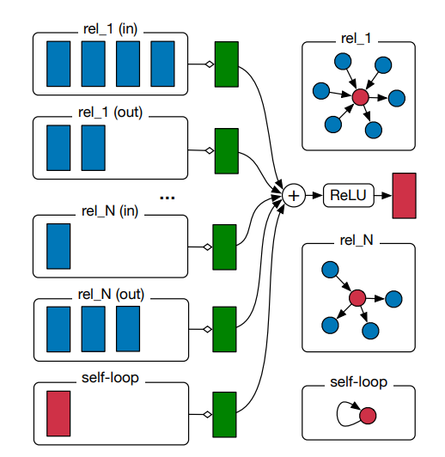
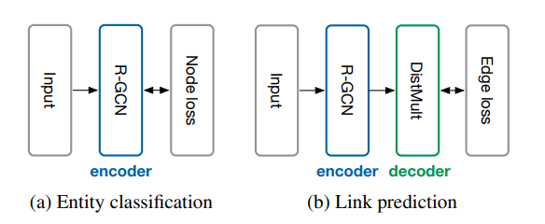
Notes:
Figure 2: Diagram for computing the update of a single graph node/entity (red) in the R-GCN model.
Activations (d-dimensional vectors) from neighboring nodes (dark blue) are gathered and then transformed
for each relation type individually (for both in- and outgoing edges).
The resulting representation (green) is accumulated in a (normalized)
sum and passed through an activation function (such as the ReLU). This per-node
update can be computed in parallel with shared parameters across the whole graph.
Figure 3: (a) Depiction of an R-GCN model for entity classification with a per-node loss function.
(b) Link prediction model with an R-GCN encoder (interspersed with fullyconnected/dense layers)
and a DistMult decoder that takes pairs of hidden node representations and produces a score for every
(potential) edge in the graph. The loss is evaluated per edge.

Slide 7
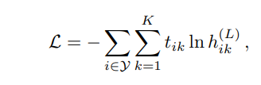
Entity Classification
For (semi-)supervised classification of nodes (entities), we simply stack R-GCN layers with a softmax function.
Minimize the following cross-entropy loss on all labeled nodes
Notes:
where Y is the set of node indices that have labels and h (L) ik is the k-th entry
of the network output for the i-th labeled node. tik denotes its respective ground truth label.
In practice, we train the model using (full-batch) gradient descent techniques.

Slide 8
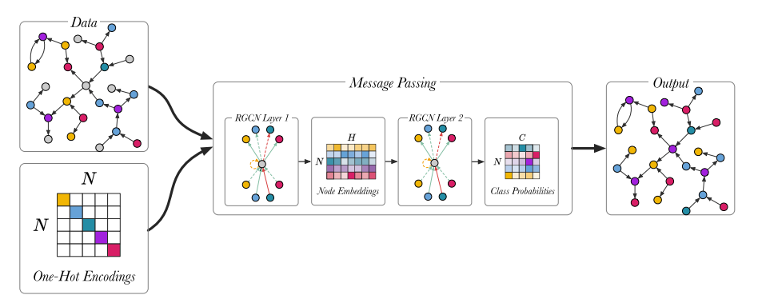
Notes:
Figure 5 shows the node classification models described in (Schlichtkrull et al., 2018),
using a two-layer model. Full-batch training is used for training the node classification model,
meaning that the whole graph is represented in the input adjacency matrix A for the RGCN.
The input is the unlabeled graph, the output are the class predictions and the true predictions
are used to train the model. The first layer of the RGCN is ReLU activated and it embeds
the relational graph to produce low-dimensional node embeddings.
The second RGCN layer further mixes the node embeddings. Using softmax activation
the second layer generates a matrix with the class probabilities, Y 2 RNC, and the most
probable classes are selected for each unlabelled node in the graph. The model is trained by optimizing the categorical cross entropy loss:

Slide 9
Processed Dataset
Labels: These represent the target labels or classes for each data point in the graph. They are typically used for training a supervised learning model.
Description tensors: These are tensors that encode the descriptions or textual information associated with each data point in the graph. They can be used as features in the graph model.
Tweet tensors: These are tensors that encode the tweets or social media posts associated with each data point. Similar to description tensors, they can be used as features in the graph model.
Number of properties: This refers to a tensor that contains numerical properties or attributes associated with each data point in the graph. These properties can be used as additional features.
Category properties: This refers to a tensor that contains categorical properties or attributes associated with each data point. These properties represent discrete categories and can be encoded as one-hot vectors or embeddings.
Edge index: This is a tensor that represents the connectivity between nodes in the graph. It typically contains pairs of indices that represent the source and target nodes of each edge.
Edge type: This is a tensor that specifies the type or category of each edge in the graph. It can be used to differentiate between different types of relationships or connections between nodes.

Slide 10
Results
Model | Accuracy | Precision | Recall | F1 Score
GCN | 67.66 | 67.27 | 67.25 | 67.23
GAT | 72.53 | 71.82 | 72.19 | 71.94
GraphSAGE | 81.07 | 80.62 | 80.89 | 80.73
SGC | 68.19 | 67.71 | 67.76 | 67.72
RGCN | 81.13 | 80.68 | 81.02 | 80.74

